Slide 1


DATA ANALYSIS
Notes:
Hello and welcome, my name is Chanchal, and today I will be presenting to you the results of the Data Analytics task.

Slide 2


Today's agenda
Project recap
Problem
The Analytics team
Process
Insights
Summary
Notes:
Today's agenda will be as follows:
1. We will recap the overall project to give a high-level understanding of the business problem we're tackling and the specific requirements.
2. We will dive into the specific problem that we, the Data Analytics team, have been focusing on and will give some background as to why this is such a big problem.
3. After introducing the problem, I will go over the team responsible from our side in tackling this task.
4. I will then go over the high-level process that we followed to complete this task so that you have complete clarity on how we tackle these kinds of tasks.
5. Finally, I will go over the all-important results and I will present them as a series of insights and visualizations from our analysis.
To wrap up, I will summarize and be open for any questions.

Slide 3

Social Buzz is a fast-growing technology unicorn that needs to adapt quickly to its global scale. Accenture has embarked on a 3-month pilot with Social Buzz to focus on 3 main tasks :
An audit of their big data practice
Recommendations for a successful IPO
An analysis of their content categories that
highlight the top 5 categories with the largest
aggregate popularity
Project Recap
Notes:
To kick things off let me recap this engagement.
We, Accenture have embarked on a 3-month pilot with Social Buzz to focus on 3 main tasks, aligned with some of the biggest challenges that you’re currently facing.
Social Buzz has reached a huge scale in recent years to become recognized as a global unicorn company. We are here to help you manage this scale and to guide you in the right direction.
Firstly, we will be doing an audit of your big data practice and sharing best practices and industry expertise. Secondly, we will be guiding you through a successful IPO, of which we have deep expertise and knowledge within our team. And finally, we have conducted an analysis of your data to find insights regarding your top 5 most popular categories of content

Slide 4

Problem
The Data Analytics team’s focus is to tackle the following issues:
to understand and crunch the vast and unstructured data that the platform of Social Buzz receives day-to-day
to gain a deeper understanding of their audience
to provide a more personalized and enjoyable experience
Notes:
Focusing on the last point that I mentioned there, this is what the Data Analytics team has been specifically focused on.
Clearly, with such a grand scale, this comes with a lot of data, and with such vast amounts of data comes challenges.
To give a background on how much data you've been creating:
- You told us that your platform receives over 100000 posts per day which amounts to 36 500 000 posts every year, of which, this is all unstructured data making it very hard to make sense of.
In this day and age, content is king. Just look at some of the biggest platforms in the world, for example, YouTube, Facebook, and Netflix... they are all content businesses...
But how to capitalize on it when there is so much?
It's not just all about harvesting as much content as possible... The real value is in understanding and crunching this content to gain a deeper understanding of your audience and to therefore provide a more personalized and enjoyable experience.
And this is where out data analytics expertise comes in, with the insights that we've uncovered from this task, we can show you exactly how to take analytics to production at scale.

Slide 5



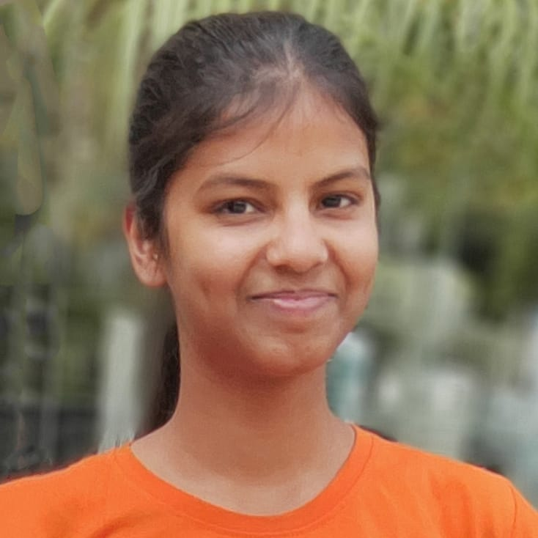
Marcus Compton,
Senior data expert
The Analytics team
Andrew Fleming,
Chief Technical Architect
Chanchal Jain,
Data Analyst
Notes:
Talking about the experience, we have a large data analytics practice at Accenture but we had a team of 3 people primarily focusing on this task.
Marcus Compton, a senior data expert has worked with the world’s biggest clients on solving their data problems and was heavily involved in the data engineering side of this project.
Andrew Fleming is our Chief Technical Architect and his expertise really helped to guide the team to produce high-quality analysis.
And finally, I, Chanchal Jain, was solely responsible for taking leadership guidance and delivering high-quality insights from the raw datasets and turning these into business decisions.

Slide 6
Process
1
Data understanding
2
. Data extraction
3
Data processing and modeling into a dataset
Gathering insights from the dataset
through visualizations
4
5
Making recommendations
Notes:
So, how did we tackle this problem?
Well, we approached it in 5 steps:
1. Data understanding - the key to success on any data project is to understand the data in detail. So we took the time to understand the data model and domain of your business.
2. Data extraction - after understanding your business, we then architected what an ideal dataset should look like for this problem and extracted it from the relevant data sources.
3. After extracting the raw data, we needed to process and model this data into a dataset that can precisely answer the business questions and produce analytics.
4. With our new dataset, we used our analytical expertise to uncover insights from this dataset and to produce visualizations to describe the insights.
5. And finally we used these insights to unlock business decisions and to make recommendations on next steps.

Slide 7

Insights
Category | Animals | science | healthy eating | technology | food | culture | cooking | travel
Number of posts | 1897 | 1664 | 1676 | 1338 | 1433 | 1395 | 1699 | 1717
Category | soccer | education | fitness | Studying | dogs | tennis | veganism | public speaking
Number of posts | 1217 | 1796 | 1457 | 1363 | 1698 | 1328 | 1647 | 1248
Notes:
From your data, we found that you had a total of 16 unique categories of posts across your sample dataset. This includes things such as animals, science, healthy eating, etc.
As well as this, there were 1897 posts from just the Animal category alone! Other than having a pet companion in real life, People obviously really like watching compassionate, and innocent beings on social media platforms too!
And also the most common month for users to post within was January 2021, i.e. when covid was at its peak in several countries across the globe, nationwide lockdowns were observed and people were working from home! January is a wintery month with so many holidays and events too and looks like people chose to stay at home during this time rather than facing the chilling weather and scary pandemic.
But now, onto the main question... what were the top 5 most popular categories of posts?

Slide 8
Row Labels | Sum of ReactionTypes.Score
Animals | 74965
science | 71168
healthy eating | 69339
technology | 68738
food | 66676
Notes:
From our analysis, you can see that the top 5 most popular categories of posts were animals, science, healthy eating, technology, and food in descending order.
Animals had an aggregate popularity score of almost 74965. To make this category content stronger, we suggest Social Buzz to introduce animal-friendly and cruelty-free strict guidelines for the users who put offensive animal content on their platform. Other than that, It is very interesting to see two pairs: healthy eating and food and science and technology within the top 5, it really shows what people enjoy consuming as content. Clearly users favor “real-life” content on this platform.
Furthermore, With Technology rapidly taking over the world, This presents a huge opportunity for you to differentiate your platform and run specific content or events linked to this global evolution, and further introduce artificial intelligence and automation tools on their platform. You can collaborate with the Tech influencers for mutual benefit.
With Food and healthy eating being in the Top 5, Social Buzz can attract food bloggers on its platform. Social Buzz can campaign with food businesses and healthy eating brands to create their social media presence for impacting the masses and charge commissions from them in return. It will increase social Buzz’s user engagement too.

Slide 9
Category | Sum of ReactionTypes. Score | Percentage
Animals | 74965 | 21%
science | 71168 | 42%
Healthy eating | 69339 | 61%
technology | 68738 | 81%
food | 66676 | 100%
Notes:
Additionally, you can see from this clustered column chart the % split of popularity between the top 5 categories. There is not much difference between each of them, Animals only outperform science by 21% within the top 5.
Interestingly, there is a roughly 20% difference in each of the Top 5 Categories of posts on the Social Buzz platform.
6th category i.e. culture is also equally popular. The rest of the Categories are also overall consistent but a drastic fall can be seen from the 9th category afterward. The low response is really shocking for one of the most loved sports like Soccer and the education and studying aspect. It must not be overlooked.

Slide 10

Social Buzz is popular among its audience for its "real-life“ and “factual” content
With “Food” and “healthy eating” being in the Top 5, It has a massive opportunity to boost its user engagement through this industry
Next step is to take this insightful analysis into large-scale production for a real-time understanding of your business. We can show you how to do this.
Summary
Notes:
So to summarize:
We tackled this task and found the top 5 most popular categories as asked, but we also went one step further.
- We found that animals and science are the two most popular categories, suggesting that users like "real-life“ content
- We also found that food and healthy eating were in the Top 5 categories. This presents a massive opportunity for Social Buzz to ride on this aspect.
- As much as this analysis was insightful, we are ready to take it to the next stage and we have the expertise within Accenture to help you realize these kinds of insights in production across your organization and in real-time. We would love to help you with this.

Slide 11
Thank you!
ANY QUESTIONS?
Notes:
Thank you very much for listening, please feel free to ask any questions that you may have!

